Slide 1
Муниципальное бюджетное образовательное учреждение «Сергачская средняя общеобразовательная школа №3» г. Сергач, Нижегородская область
Презентация по английскому языку ученицы 9 класса
Тема: «What is hot with young generation?»
Автор:
Ученица 9 «В» класса Вероника Ф.
Руководитель :
Поняева Наталья Валерьевна
учитель английского языка МБОУ «Сергачская СОШ №3»,
высшая квалификационная категория
Сергач 2020

Slide 2
Personal information
name: Veronika
surname: Filyasova
birthdate: 14 September 2002
age: 15
place of residence: Sergach

Slide 3
Family
I think the family of today's young generation is not at the last place.
The preservation and strengthening of family authority in the minds of young people, of course, is a priority for modern society. As a necessary component of the social structure of any society, the family plays an important role in social development.
The family is the primary socialization and the education of children, and for me family is a place where me love and can support in any situation.

Slide 4
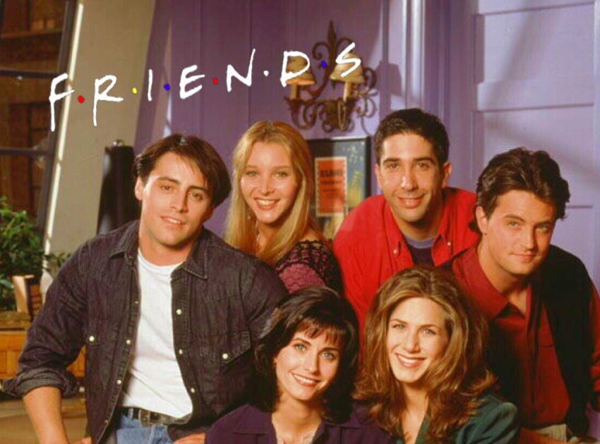
Friends
«A friend is one soul living in two bodies»
Aristotle
Friendship for teens is an important component of life. At this age, there is a need for faithful friend. For most of the younger generation friends are everything.
Most often friendships are based on common interests, friends spend a lot of time together, support each other. I think I would feel absolutely lonely without my friends.

Slide 5
Hobbies
We can often hear that today's young generation are very lazy and anything not capable of. But currently, young people have unlimited freedom when choosing their leisure time. Technological progress, more and more attracts the young in the "virtual world". Although there are those who are using the Internet discover the new modern trends in sports or art. For example, my hobby is needlework, watching movies and learning English.
Top modern youth hobby:
Reading
Travel, tourism
Photo
Cooking
House plants
Hunting and fishing
Collectables
Sport

Slide 6
My goal in life
to finish school and University
to proficient in English and a few other widespread languages
to travel around the world
a lot of reading
to help friends and closed people
to go to concerts of my favorite music groups
become an interesting person

Slide 7
Conclusion
The system of values of young generation is a mix of traditional values: family, health, friends and values related to success: money, independence, self-fulfillment, etc. Balance between them is fragile, but perhaps in the coming decades based on it formed a new stable system of values of society.

Slide 8
thanks for attention!

Slide 9
Источники:
1. Учебник предметной линии «Английский в фокусе» 9 класс, Ю.Е. Ваулина, Д. Дули, О.Е. Подоляко, В. Эванс. М.: Express Publishing: Просвещение, 2019 г.
2.Все обо мне ( Электронный источник) Режим доступа: https://i.pinimg.com/736x/9a/5a/57/9a5a57011330dc8efb3601923f5e9b6d--all-about-me-worksheet-the-pen.jpg
3. Семья ( Электронный источник) Режим доступа: https://www.vesti14.ru/wp-content/uploads/2018/06/fb7b54b0cddfc787f413338ed5ec1e75.jpg
4. Друзья (Электронный источник) Режим доступа: https://www.ukrnews24.net/wp-content/uploads/2016/01/384959413.jpg
5. Увлечения (Электронный источник) Режим доступа: https://www.ckziu.com/images/zdjecia/Doradca_zawodowy/hobby_design_elements_various_symbols_isolation_colorful_decoration_6827532.jpg
6.Цель в жизни (Электронный источник) Режим доступа: https://www.iaspaper.net/wp-content/uploads/2017/11/Achieve-Goals-in-Life.jpg
7. Молодость.(Электронный носитель) Режим доступа: https://sun9-70.userapi.com/c857136/v857136332/170e47/8t5Ld9ZbwIs.jpg

