Slide 1
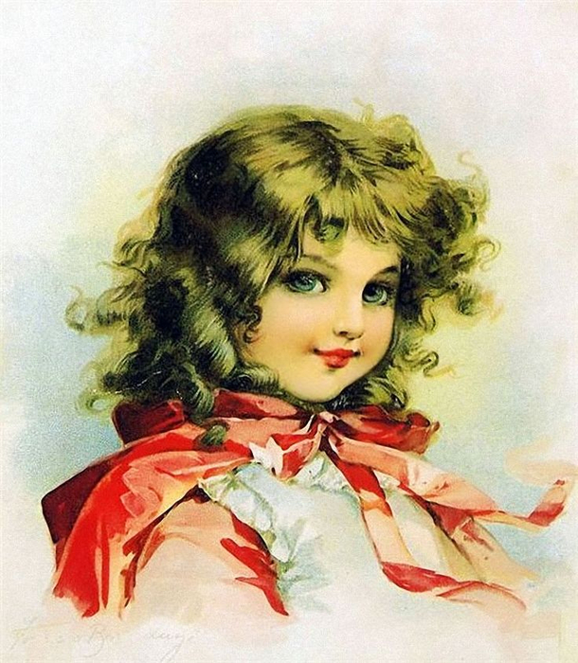
tender portraits’ empire
Art Gallery
for the 5th -11th Grades
Автор:
Ольга Михайловна Степанова, учитель английского языка
МБОУ «Цивильская СОШ №1
имени Героя Советского СоюзаМ.В. Силантьева»
города Цивильск Чувашской Республики
2019

Slide 2
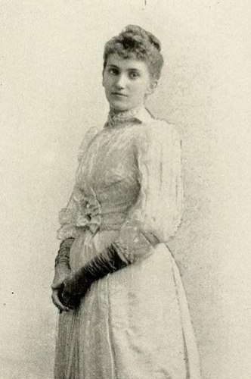
Meet Maud Humphrey!
(March 30, 1868 – November 22, 1940)

Slide 3
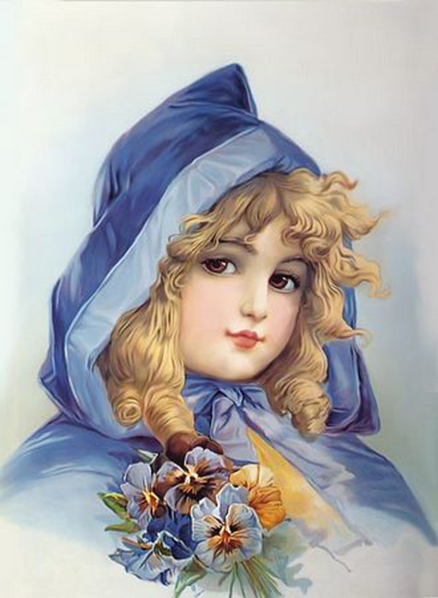
Maud Humphrey was a commercial illustrator, water colorist, and suffragette from the United States.

Slide 4
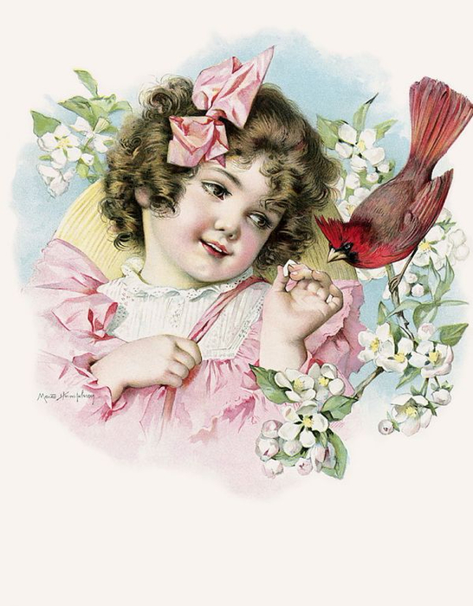
She is now known for being the mother of Academy Award winner Humphrey Bogart,one of the most famous Hollywood legendary actors

Slide 5
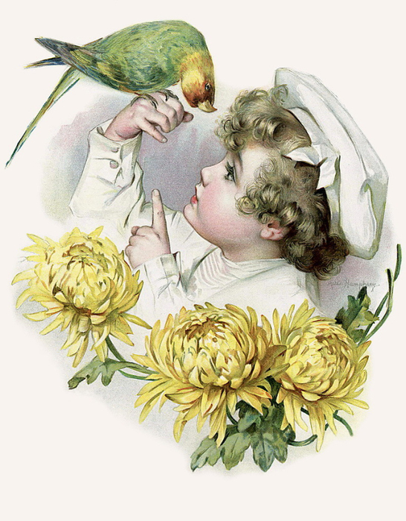
Humphrey was born in Rochester, New York in 1868 to John Perkins Humphrey and Frances V. Dewey Churchill. She displayed an early talent for art, which was fostered by evening art classes from the age of 12.

Slide 6
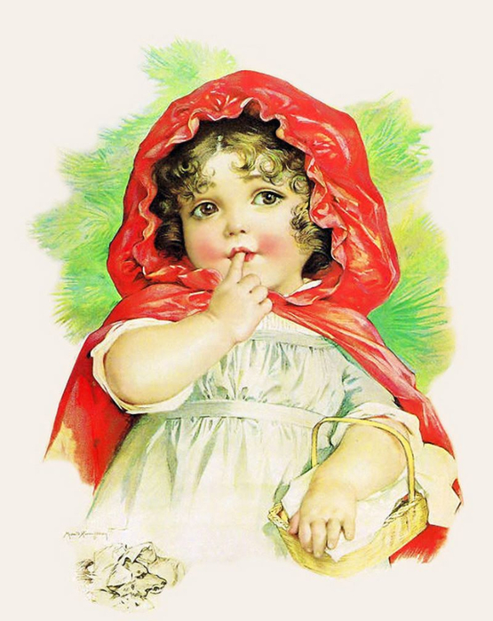
By her late teens, the skilled artist landed her first commissions for black-and-white illustrations in children’s magazines, and at eighteen, she moved to New York, where she enrolled at the recently founded Art Students League.

Slide 7
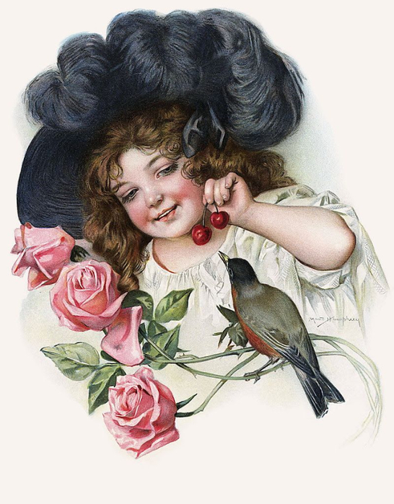
From there she journeyed to Paris for further study at the Julian Academy, and managed to train under James McNeill Whistler.

Slide 8
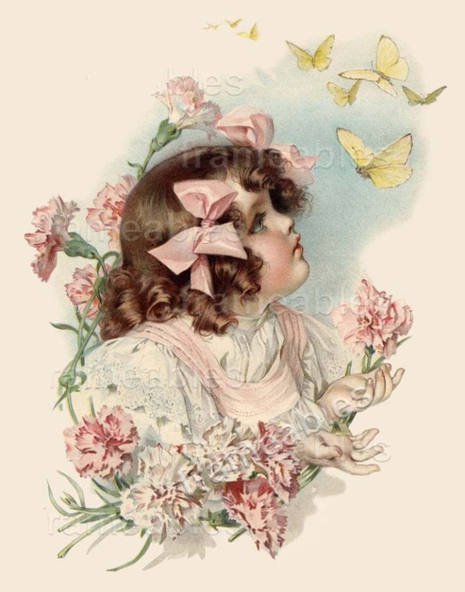
She won a Louis Prang and Company competition for Christmas card design and then began working for the New York publisher Frederick A. Stokes Company as an illustrator.

Slide 9
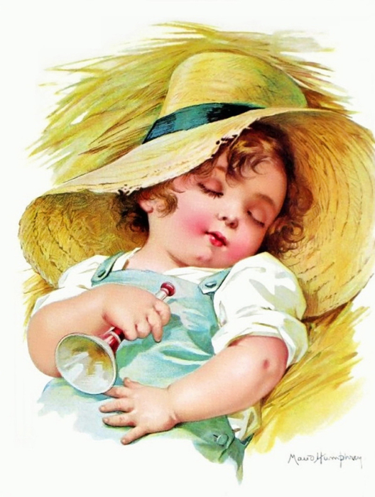
From the 1890s through the 1920s, her work Included child portraits, "illustrating calendars, greeting cards, postcards, fashion magazines, and more than 20 story books.

Slide 10
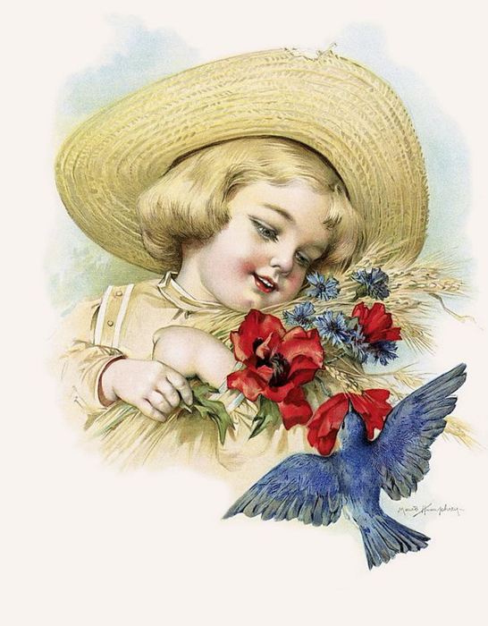
Maud’s chosen medium was watercolor, and her distinctive dry watercolor technique lent well to her sketches of babies and children.

Slide 11
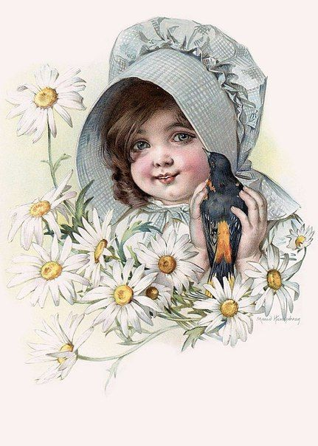
She collaborated with her sister Mabel on two miniature books, published by Stokes Co.

Slide 12
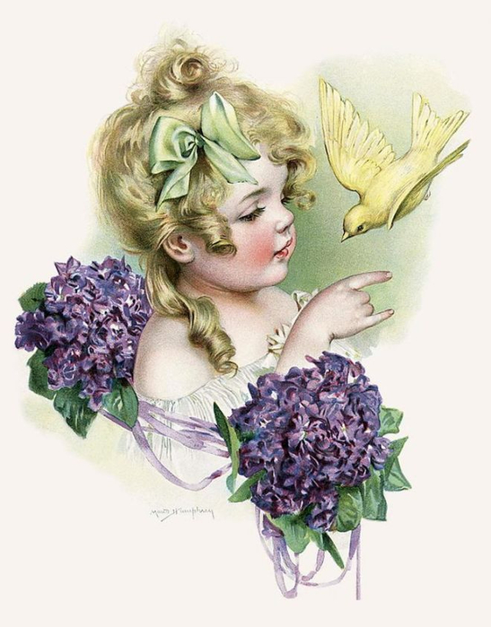
Her marriage to Dr. Belmont De Forest Bogart, a fashionable surgeon, pushed them into the Social Register, and Maud’s talents–which included exceptionally popular books of her illustrations, and the ad campaign for Mellins Baby Food.

Slide 13
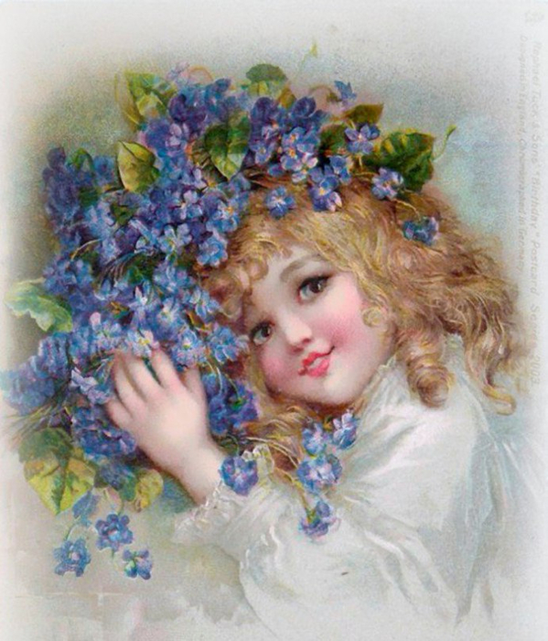
She maintained her art career even after marriage and a family.

Slide 14
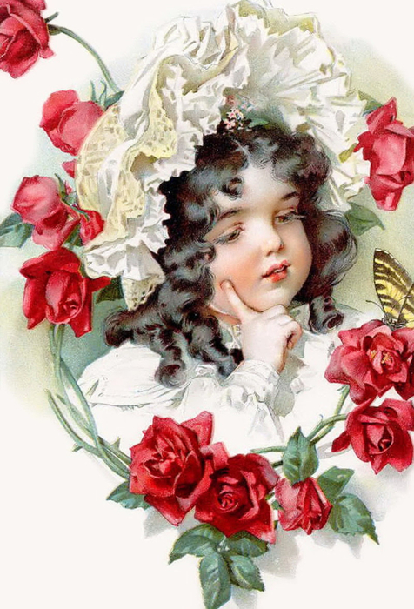
Today,
there is
a resurgence of interest
in Maud Humphrey’s work.

Slide 15
Thank you
for visiting our gallery!
See you

Slide 16
Источник:
Maud Humphrey https://en.wikipedia.org/wiki/Maud_Humphrey
Maud Humphrey Bogart https://www.pinterest.ru/topsrose/maud-humphrey-bogart/?lp=true
Maud Humphrey https://www.schifferbooks.com/maud-humphrey-her-permanent-imprint-on-american-illustration-2243.html
Fascinating Women: Maud Humphrey http://www.edwardianpromenade.com/women/fascinating-women-maud-humphrey/
Изображения взяты на сайте http://yandex.ru
Условия использования сайта https://yandex.ru/legal/fotki_termsofuse/

